Slide 1

NativeScript & Angular 2
🔥 Building performant native mobile apps 🔥
Open https://nativescript.github.io/developer-day-workshop/

Slide 2
NativeScript is…
an open source framework for building truly native iOS and Android apps with JavaScript or TypeScript.

Slide 3
5 reasons you should care
🐷🐝🐼🐶🐸

Slide 4
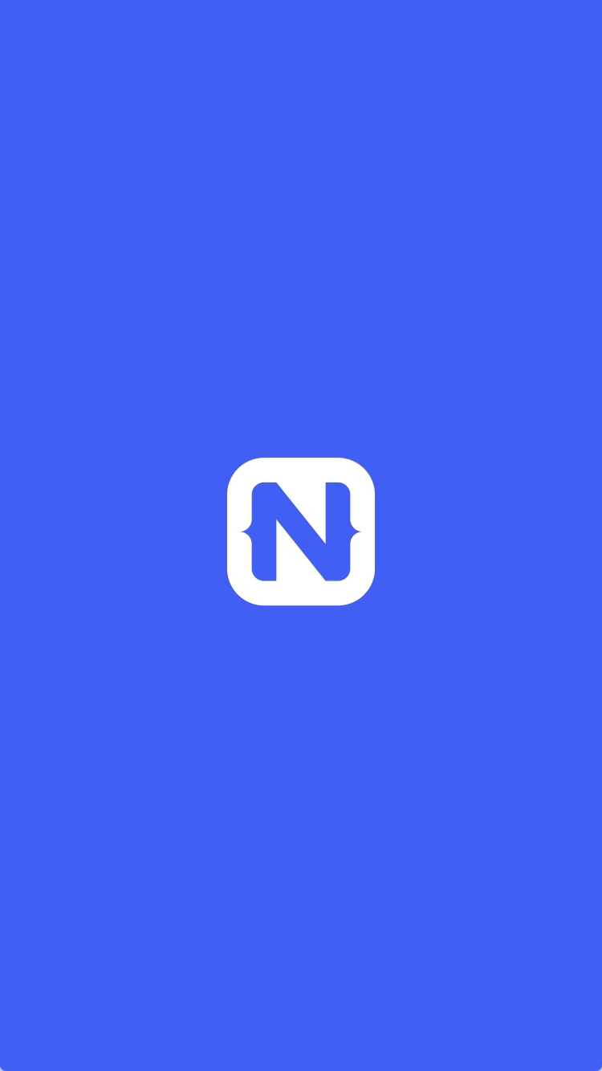
1
Rich, animated, “no compromise” native UI 🏎
(with shared UI code)
Search for
“Examples NativeScript”
in the iOS App Store or Google Play to try this out for yourself.
Notes:
Mention UI for {N}

Slide 5
2
JavaScript/TypeScript
Angular
CSS
3rd-party libraries
Npm
CocoaPods
Android Arsenal
Maximum code and skill reusability 📱🖥
Notes:
Npm, CocoaPods, Android Arsenal

Slide 6



3
First-class Angular and TypeScript support 👑
+
=

Slide 7

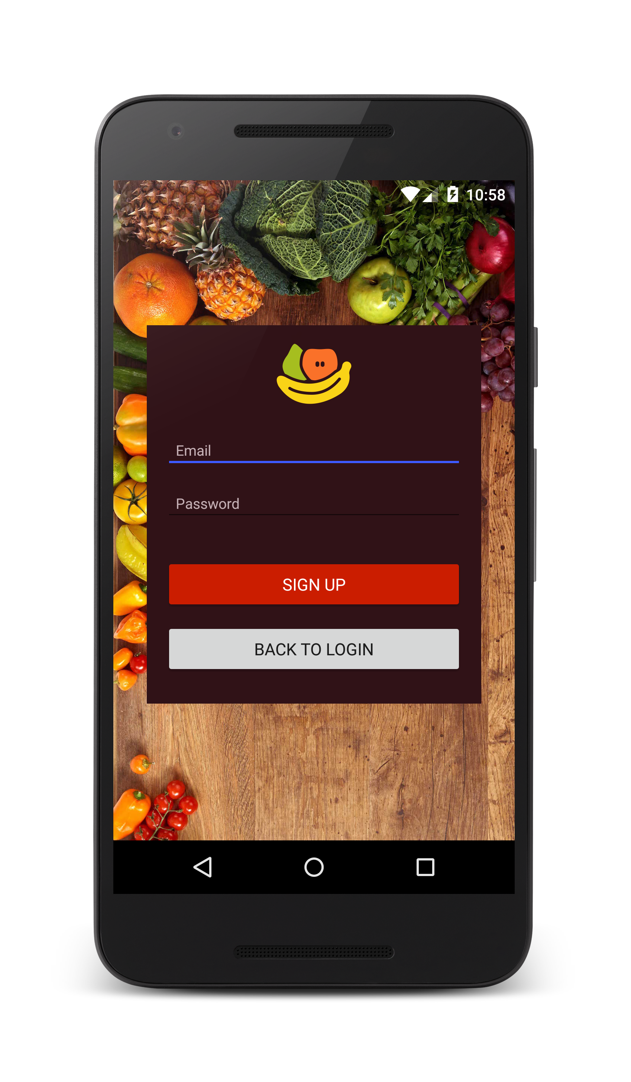

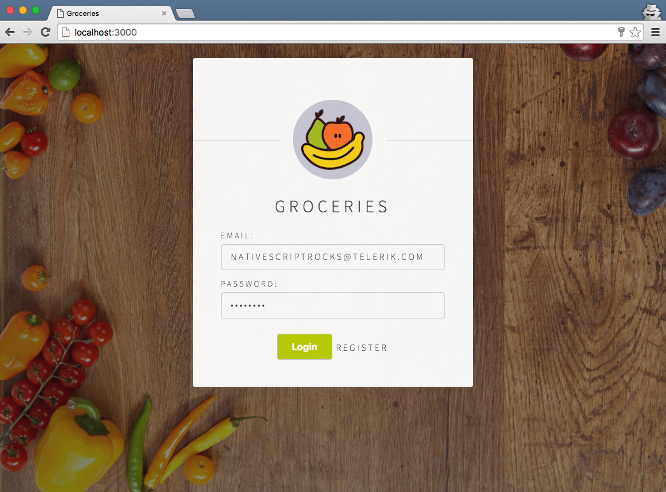
Android
iOS
Web
Notes:
Jen

Slide 8
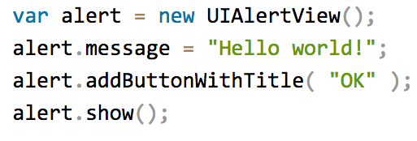
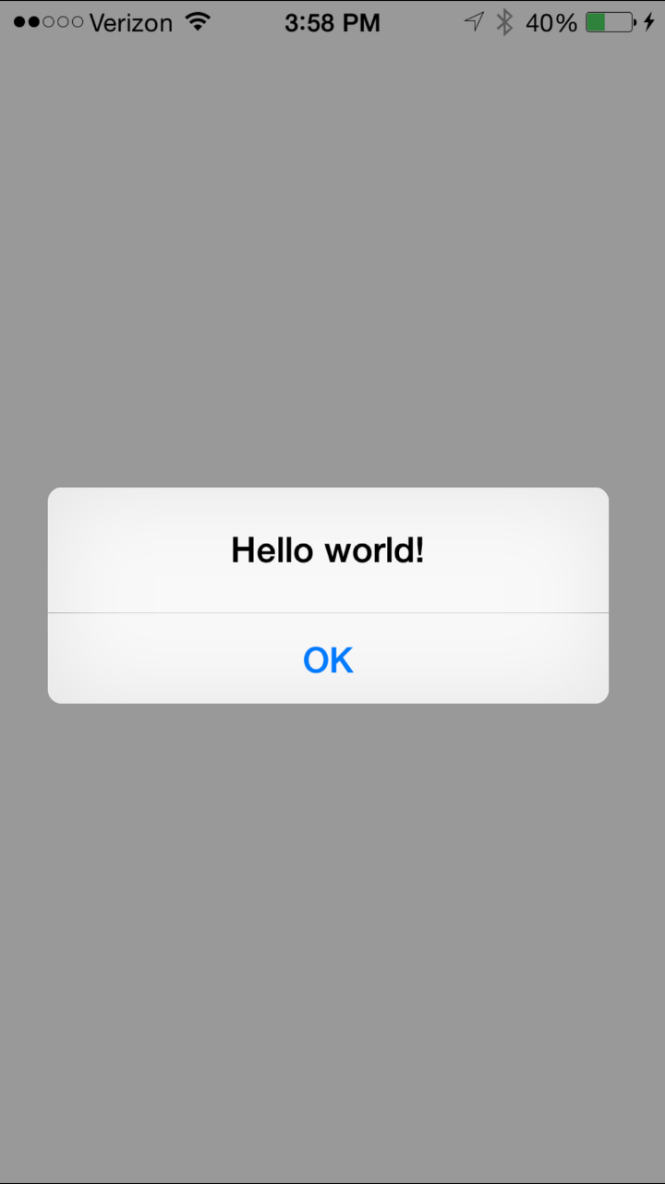
4
100% access to Android and iOS APIs 📷 ⏱ 🗺
Notes:
This is valid NativeScript JavaScript/TypeScript code, but it’s hitting iOS APIs.

Slide 9
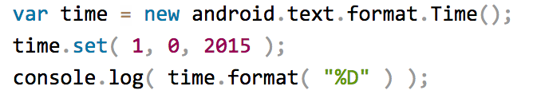


Runs on V8 JavaScript VM
Runs on JavaScriptCore VM
More details at http://bit.ly/how-nativescript-works

Slide 10
Android and iOS APIs 🚪🏃

Slide 11
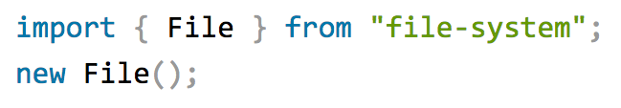

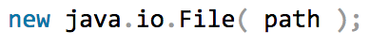

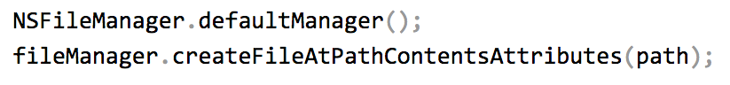
Example: NativeScript file module 📚

Slide 12
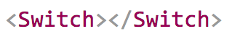
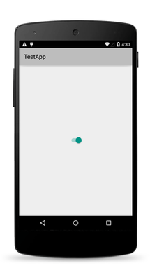
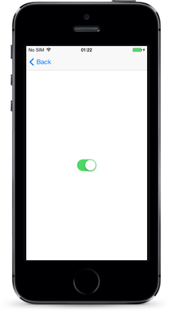
The same approach works for the UI 🖌

Slide 13
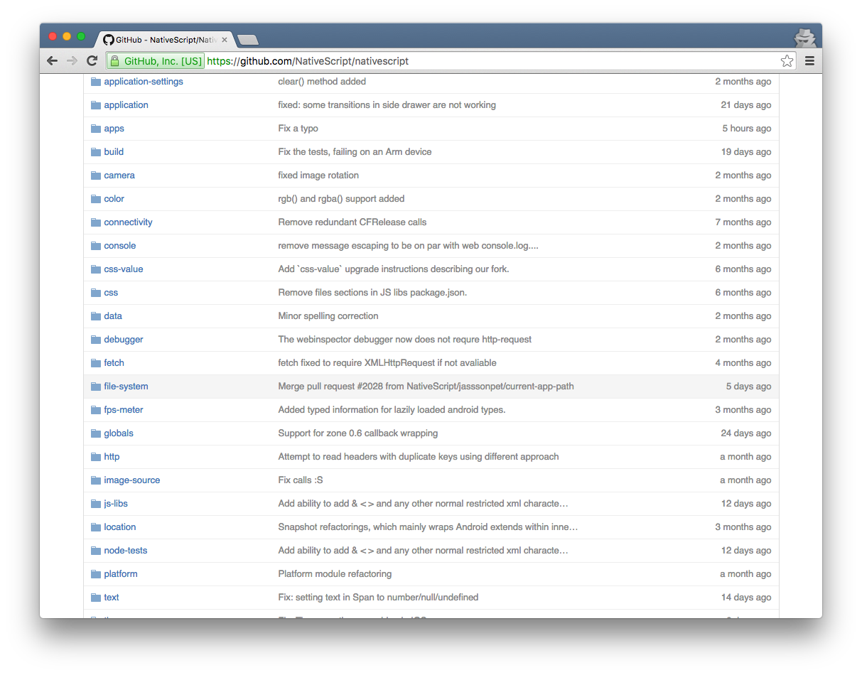
NativeScript Modules—There are a lot 🚚

Slide 14
5
Supported by a major software company vested in your success ⚽
Notes:
Who is Progress?
How do we make money from NativeScript?
UI for {N}, Platform

Slide 15
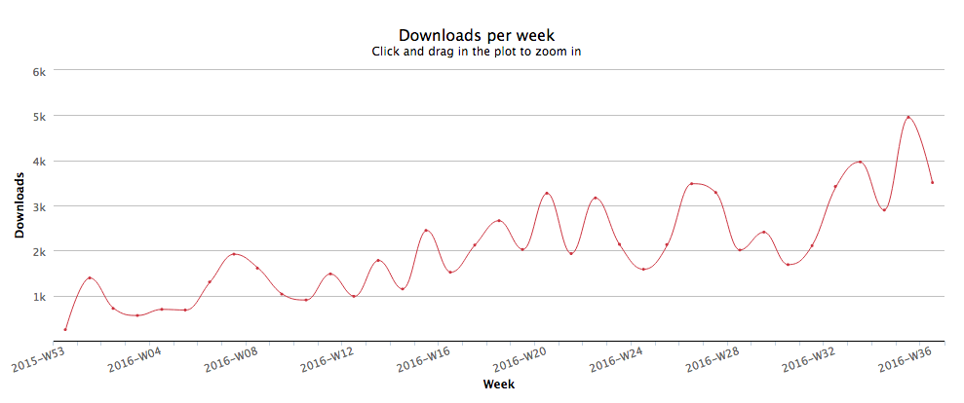
NativeScript is Growing 🛩
Weekly npm downloads of the “nativescript” package in 2016.

Slide 16
Hands-on workshops! ⛵

